Slide 1
Counting Large Distances in Convex Polygons A Computational Approach
Filip Morić and David Pritchard, EPFL
August 30, EuroComb 2011

Slide 2
Background: Counting Diameters
Point set diameter: largest pairwise distance
Given n points in the plane, what’s the maximum # of pairs whose pairwise distance equals the diameter?
can be at least n:
also, at most n (Hopf & Pannwitz 1934)

Slide 3
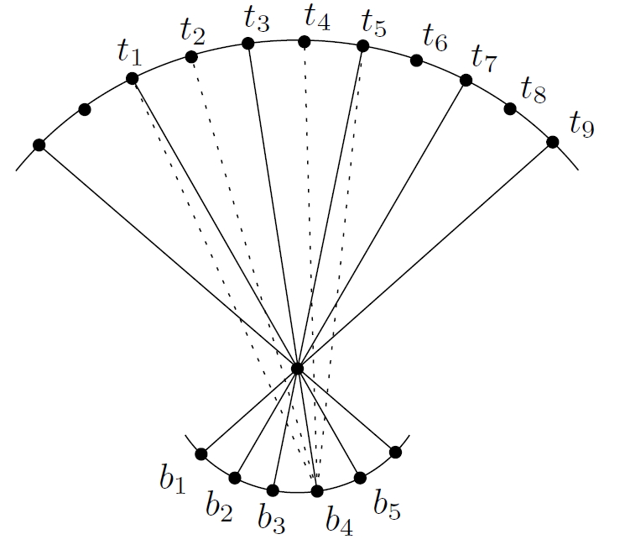
Large Distances
d₁ > d₂ > d₃ … := all distinct pairwise distances
d₁ is the diameter, d_{k} the k^{th}-longest distance
Our focus: extremal questions on occurences of these large distances in convex sets
Let m_{i} be the number of times d_{i} occurs
Vesztergombi 1985: m₂ ≤ 4n/3 & this is tight

Slide 4
Convex Top-k Distance Conjecture
Erdős, Lovasz, Vesztergombi (‘89) conjectured: m₁ + m₂ + m₃ + … + m_{k} ≤ kn
call a distance in {d₁, d₂, …, d_{k}} a top-k distance
tight again for odd regular polygons
true for k=1 [H & P ‘34], k=2 [Vesztergombi ‘85]
[ELV ‘89] proved an upper bound of (3k – 1)n
We verify the conjecture for k=3, 4 and large n
& give an upper bound of (2k – 1)n in general

Slide 5
Levels
0
0
1
The diagonal from point x to point y is said to belong to level q where x + y ≡ q (mod n)
Level 3 and level 5 of two point sets are shown
6
1
6
2
5
2
5
4
3
4
3

Slide 6
Long Pair Lemma & First Result
The Long Pair Lemma:
Lemma: min{A, B} ≤ i + j – 3.
Corollary: each level has ≤ (2k – 1) top-k distances.
Implies m₁ + m₂ + m₃ + … + m_{k} ≤ (2k – 1)n!
… (points) …
d_{i}
A points
B points
d_{j}
… (points) …

Slide 7
Proving the Long Pair Lemma
d_{i}
d_{k, k<i}
Prove min{A, B} ≤ i + j – 3 by induction on i + j
Base case i=j=1: two diameters must cross
Inductive step: the red quadrangle has at least one obtuse angle, WOLOG the one shown
Next diagonal has length > d_{i}: length d_{k} for some k < i
Apply induction to it and the opposite diagonal ✔
A points
B points
d_{j}
Triangle inequality implies sum of red lengths > sum of blue lengths ✔

Slide 8
Computing
Other results use a computer program
Automate a certain case analysis and proof method
Illustration: we show how the method would be used to obtain Vesztergombi’s result, m₂ ≤ 4n/3.
(we skip a technicality about “special diagonals” which is why our results hold only for large n)

Slide 9
Computer’s Lemma
For every level q, one of the following holds:
≤ 1 = ⌊1⋅4/3⌋ level-q diagonals have length d₂,
≤ 2 = ⌊2⋅4/3⌋ level-{q, q+1} diagonals have length d₂,
≤ 4 = ⌊3⋅4/3⌋ level-{q…q+2} diagonals have length d₂,
≤ 5 = ⌊4⋅4/3⌋ level-{q…q+3} diagonals have length d₂.
Corollary: levels have at most 4/3 d₂’s on average.
thus m₂ ≤ 4n/3 follows.
Cyclic order of levels
{5, 6}
{1, 2, 3, 4}
{7, 8, 9}

Slide 10
A Finite Methodology
How can a finite computer-based exhaustive search prove the “Computer’s Lemma”?
Pertains to d₂’s in up to 4 consecutive levels
By Long Pair Lemma, any two d₂’s cross, or are next-to-adjacent (on one side)
So any two d₂’s in levels {q,…,q+3} have ≤ 4 vertices between them on both sides
So all d₂’s in these levels fit in a bipartite graph w/6 consecutive nodes per side

Slide 11
Ingredients: Geometric Facts
triangle inequality applied to pairs
Long Pair Lemma
Altman 1963: if |af| ≥ max{ |ad|, |cf| }, then |be| > min {|bd|, |ce|}.
Not intuitive why it is useful, but without it, weaker results are obtained
a
b
c
d
f
e

Slide 12
Recipe for a Computer Search (in Java)
2 consecutive disjoint intervals of points
store the possible distance {d₁, d₂, …, d_{k}, <d_{k}} of each edge hitting both intervals,
use the geometric facts to skip impossible configurations
iterative approach — start with small configurations, grow until no more d_{k} can occur

Slide 13
A Typical Step of the Algorithm
|tb’|+|t’b| > |tb|+|t’b’|
RHS = 2d₂, and |t’b| ≤ d₂, so |tb’| > d₂
t
t’
t
t’
{d₁, d₂, d₃, <d₃}
{d₂}
{d₂}
{d₁}
{d₂}
{d₂}
{d₂, d₃, <d₃}
{d₂, d₃, <d₃}
b
b’
b
b’

Slide 14
Computational Results (for n large)
Main result: at most 3n top-3 distances, and at most 4n top-4 distances
m₁+m₃ ≤ 2n
tight for odd regular polygons
m₃ ≤ 3n/2, m₂+m₃ ≤ 9n/4
abstractly tight (next slide)
m₄ ≤ 13n/8
we doubt it is tight, even abstractly

Slide 15
Abstract Tightness
d₃
< d₃
m₃ = 3n/2, satisfies chosen geometric facts
Are these embeddable? If not, can we add a geometric fact to our abstraction?
top
bottom endpoint location

Slide 16
Thanks for your attention!
Questions?

