Slide 1
Computer Science Circles Python in your Browser
David Pritchard (Princeton University) and Troy Vasiga (University of Waterloo)
thanks: Brice Canvel, Graeme Kemkes, Andy Kong, Sandy Graham
Center for Education in Mathematics and Computing (CEMC),
University of Waterloo
Notes:
Before talk:
- Write down crib notes
Clear my records for problems completed in lessons 0, 1, and 10
Import datetime datetime.date.today().year

Slide 2
Goal
Can everyone experience programming?
Ingredients:
A web browser, no installation needed
Engaging programming exercises
You learn by doing!
Help students test their code
Instructional narrative aimed at novices
What environment best supports this?

Slide 3
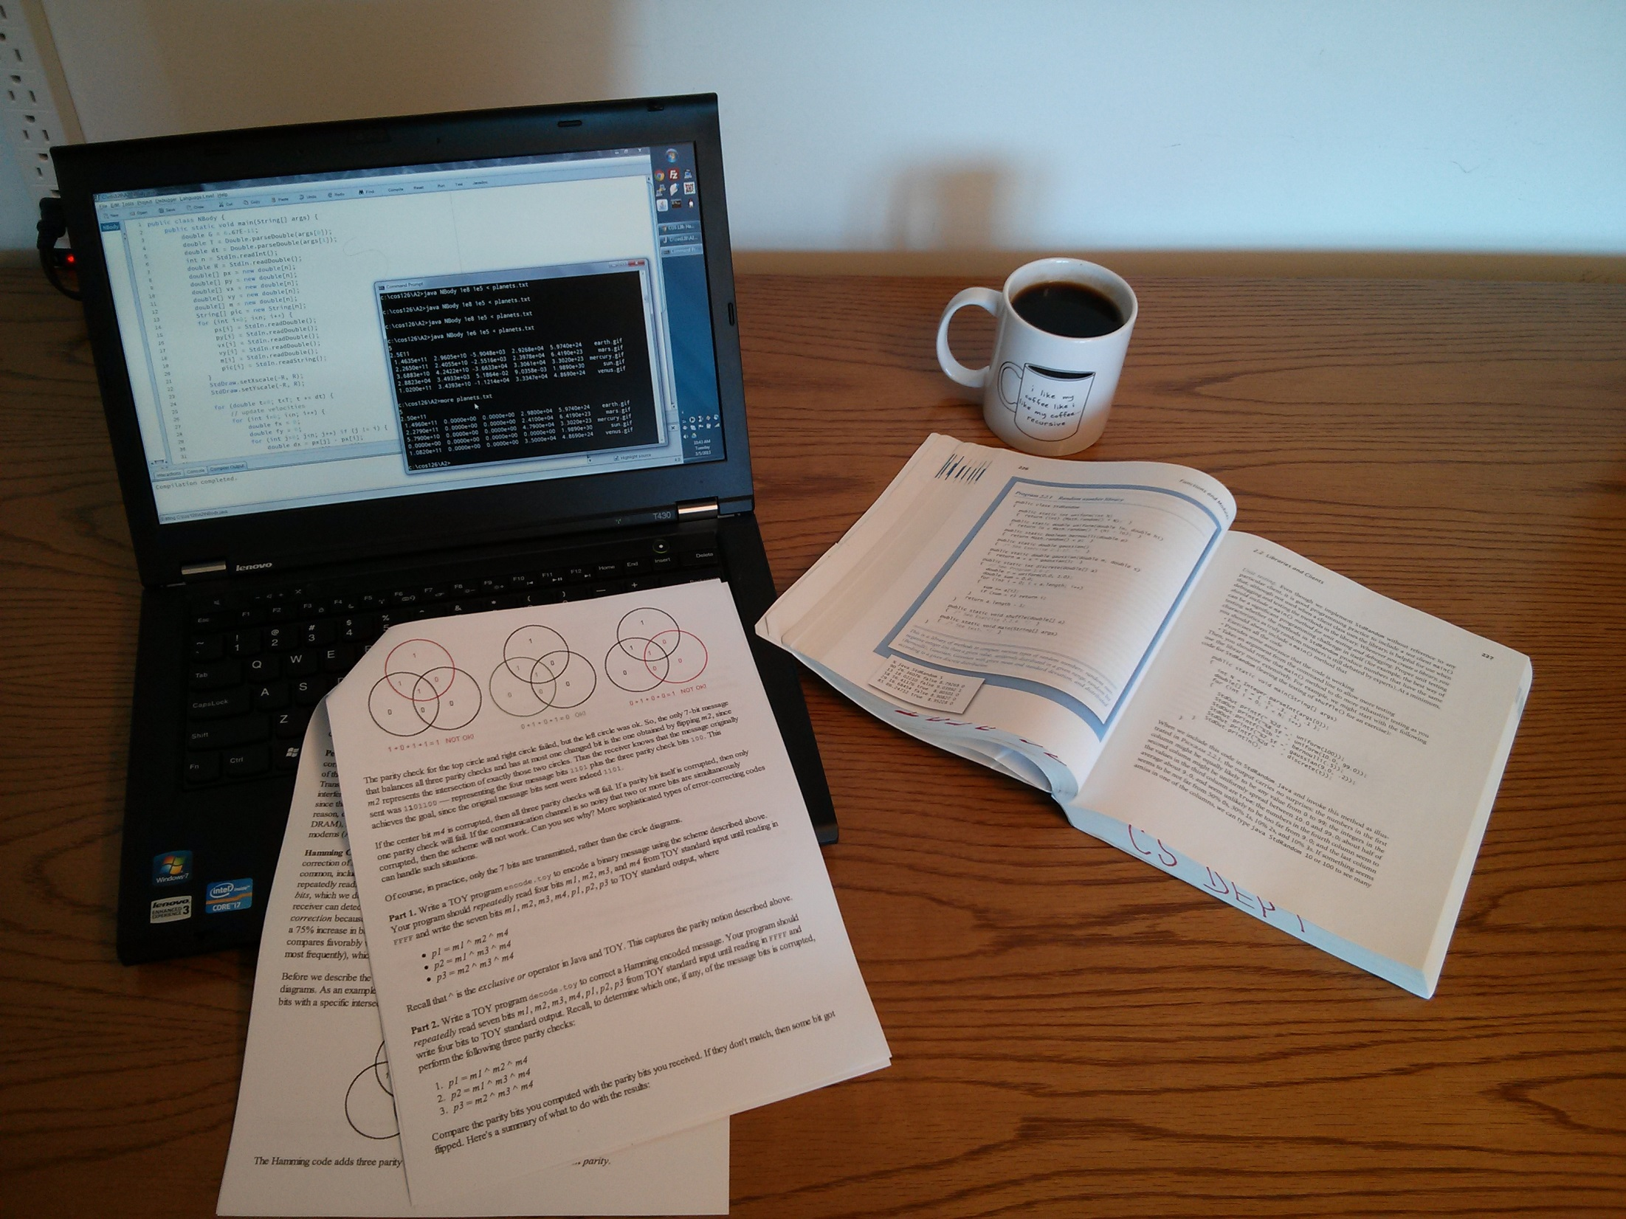

Slide 4
Short Tour
Basic UI
Different automatic grading methods
Crafting lessons
Hints
Exercises other than plain coding
Student tools
Console
Visualizer (Philip Guo, this session)
My Progress
Notes:
(Three tabs pre-opened: L0, L10, My Progress)
Lesson 0: *Example code, *example broken code
Lesson 0: *First exercise, *basic grader, *checkmarks
Lesson 0: *Hint boxes, *Help, *History, *Next button
Lesson 1: *Short answer, *drag and drop, *accordion hints
Lesson 1: *Variable grader
Lesson 10: *Function grader, *Rich editor, *Test
*Console
*Visualizer
*“My Progress” page
*Range of content, reorderability

Slide 5
Users
Students
10000 registered users
Teachers
“Help” questions redirect to teacher (demo)
Can review progress of students
Currently 26 teachers, with 500 students
Lesson/Exercise Authors

Slide 6
Exercise Markup
An exercise simple to state in words should be simple to put in your lesson!
Our approach: WordPress shortcodes
Written and edited within lesson text
Demo of editing in-browser
Notes:
Open lesson 10 for editing
Go to “cube”
Change to fourth power
Add test case: from datetime import date\ncube(date.today().year)

Slide 7
Grader
Other exercise options
Taboo words or symbols in source code
Limit edit distance from buggy version
Sandboxing (Mooshak safeexec)
Constrains process using OS-level tools
Works with languages other than Python
Fork available on GitHub

Slide 8
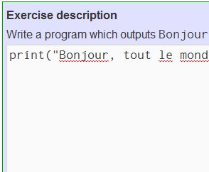
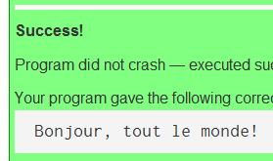
How Is It Built?
WordPress plugins + customizations
Other open-source components: Visualizer, CodeMirror editor, Flexigrid database viewer
Server
User
WordPress (PHP + SQL)
print("Bonjour,
Grader (PHP)
Sandbox
Asynchronous JavaScript (ajax)

Slide 9
Usage Statistics
Each day,
3000 page views
10000 submissions
40 new users
1000 visualizations
French-language version represents 4% of CDN traffic, 8% of European
About half of traffic is logged in, half not

Slide 10
What We’ve Learned
DP, TV, SG answered 1000+ help requests
Feedback is incredibly valuable: improves material, test cases, hints, interface
Exponential decay in #students completing an exercise, as function of position in course

Slide 11
Feedback Letters
Parent-child teams, bioinformatics PhDs, workers in remote locations, retirees
Most common compliment:
The exercises are challenging (as opposed to “type this after me”) and rewarding/addictive
The world is hungry for more! Requests for similar sites in C++, Java, JavaScript

Slide 12
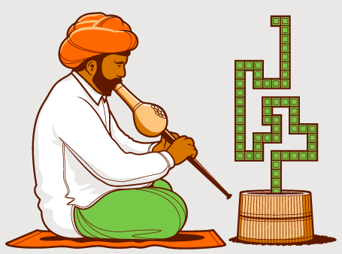
Future Work
Advanced Python
Binary, printf, map/filter, …
Other languages (DE, NL)
Sharing our source code?
Refactoring needed to make it usable
Is there an audience?
Mining our data
Giving automatic hints with error messages

